Slide 1
Reliable and affordable electricity: the fuel for economic growth
prepared for the
Rethinking Electricity Forum at CIGRE 2026
Paris, France
Julia Frayer
August 14, 2026

Slide 2
Reliable and affordable electric service is a necessary ingredient to securing sustainable economic growth
Introduction
Treat reliability as non-negotiable
Reliable electricity creates the foundation for investment, productivity, and participation in modern supply chains
Recognize role of demand-side participation in wholesale market design
Markets should reflect not only the cost of producing electricity, but also the true value of reliable and flexible electricity to electricity customers
Electricity sector should be built around the “customer”
Market design, planning should enable the industries, technologies, and economic activities that the power system is expected to support
Make reliability and flexibility a focal point of market design, planning rules
Capability, ancillary services, resilience, and power quality are fundamental components of dependable electricity service, but typically overshadowed by energy
Create durable arrangements that can withstand political pressure
Realistically, we cannot eliminate political intervention – so how do have credible and investable commercial arrangements that are not destabilized?
Ensure that electric power systems improve outcomes for all customers
Well-designed investment can spur demand growth, which in turn improves grid economics, affordability, and reliability for households and small businesses

Slide 3
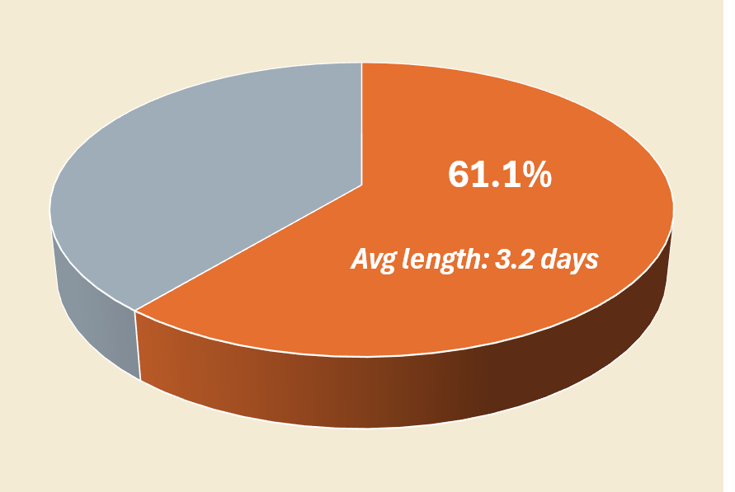
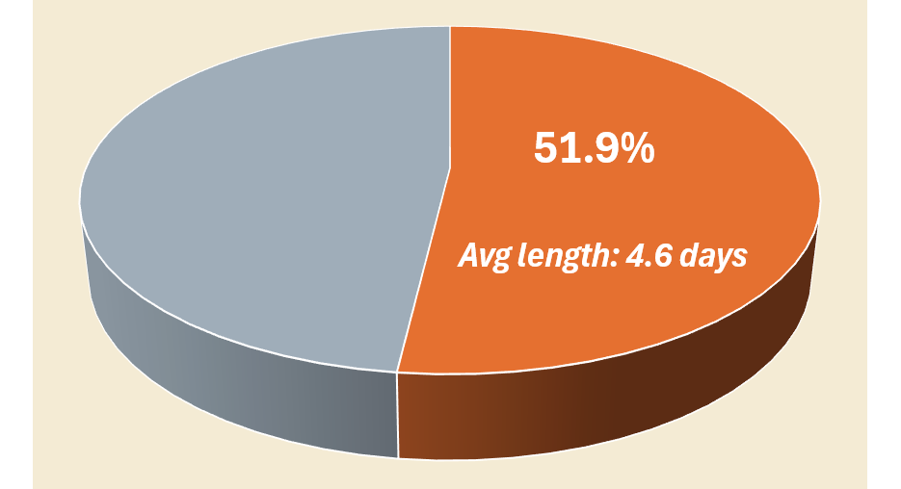
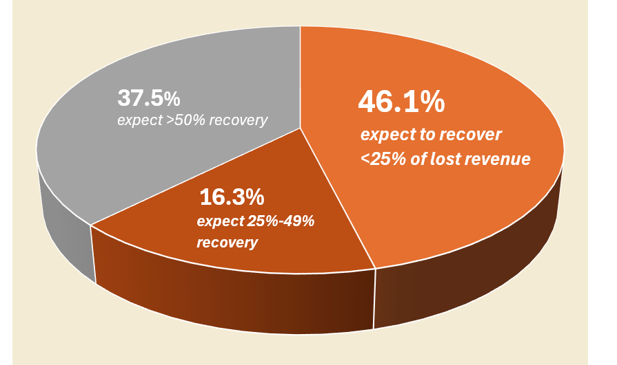
Unreliable power raises the real cost of doing business - in Texas, the Federal Reserve Bank of Dallas estimated economic losses totaling billions from Storm Uri outages
Reliability is non-negotiable
Lost economic output in Texas due to Storm Uri (February 2021)
Firms reported losing an average of 13.6% of their February revenue as a result of Storm Uri
Manufacturing was hit hardest: 83.3% of firms shut down for an average of 5.1 days, losing 20.5% of February revenue
Share of Firms Experiencing Power Loss
Share of Firms Experiencing a Complete Shutdown
Lost Revenue Expected to Be Recovered Within 4 Weeks
Notes: Data are based on a March 2021 Federal Reserve Bank of Dallas survey of 385 Texas business executives on Storm Uri’s impact on their businesses.
Various estimates of losses caused by the freeze and outages during Storm Uri across different studies:
Texas Department of Insurance data indicated approximately $11.5 billion in ultimate insured losses
An estimate acknowledged by the Dallas Fed and the Texas Comptroller placed direct and indirect losses to the Texas economy at $80–$130 billion – equivalent to 4-6% of the state’s 2021 GDP
An economic research firm estimated $197–$296 billion in total expenditure impacts after accounting for multiplier effects, including $86–$129 billion in long-term losses in gross product
Sources: Federal Reserve Bank of Dallas (March 2021), Federal Reserve Bank of Dallas (April 2021), Texas Department of Insurance (2022), FRED, LEI analysis.

Slide 4

Power grid disruptions are a worldwide phenomenon and not limited to specific economic, technical or demographic conditions
Reliability is non-negotiable
Balkan Region 2024 Extreme heatwave
Pakistan 2023 Grid frequency failure
Iberian Peninsula 2025 Overvoltage
SUSAN
Cuba 2022 Hurricane Ian
Taiwan 2022 Transformer malfunction
Chile 2025 Transmission failure
South Africa 2020 Load shedding
Across this sample of six major power system disruption events, over 375 million people affected
Sources: Al Jazeera, France 24, CNN, The Citizen, Business Insider, ABC News, The Associated Press.

Slide 5
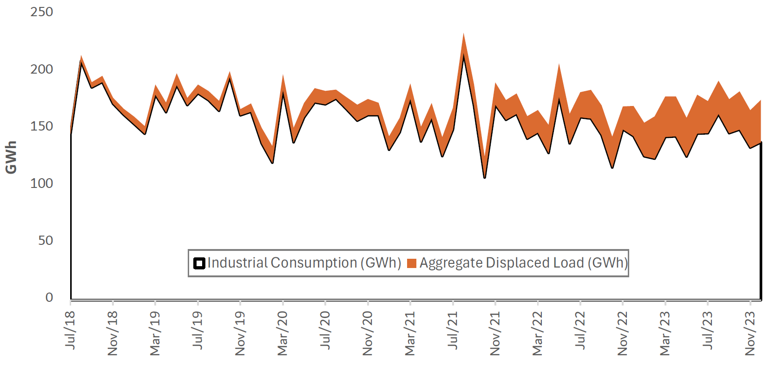
Customers are forced to find and finance alternatives, if they cannot get reliable power from the grid… and those alternatives are costly
Reliability is non-negotiable
Puerto Rico: Monthly industrial billed load vs. estimated CHP-displaced load, July 2018 – November 2023
Puerto Rico: Monthly Commercial and Industrial Customers’ (“C&I”) Self-Generation Capacity**
Sep 2019:
Hurricane Dorian
Tropical Storm Karen
Jan 2020:
Puerto Rico Earthquakes
Jul 2020:
Tropical Storm Isaias
Aug 2021:
Tropical Storm Fred
Sep 2022:
Hurricane Fiona
43 large industrial and commercial customers reduced grid electricity consumption through new Combined Heat and Power (“CHP”), displacing +400 GWh in 2023
What is the cost of self-generation?
In 2024, the average retail electricity price in Puerto Rico was about 24 cents/kWh, over 40% above the U.S. national average. The estimated levelized cost of a reliable self-supply solution* totaled to over 35 cents/kWh, making it 45% more expensive than electricity supplied by the utility
Puerto Rico’s businesses have steadily increased deployment of behind the fence generation in last 10 years, more than doubling such generation capacity from 70 MW to 160 MW
Note: (*) This estimate based on a 3 × 1 MW genset configuration to meet a high load factor industrial customer consuming 2 MW on peak (N-1 design for redundancy).
Note: (**) This capacity counts both net metering and non-net metering projects, based on data reported to the EIA.
Sources: LUMA, LEI analysis, and U.S. Energy Information Administration (“EIA”).

Slide 6
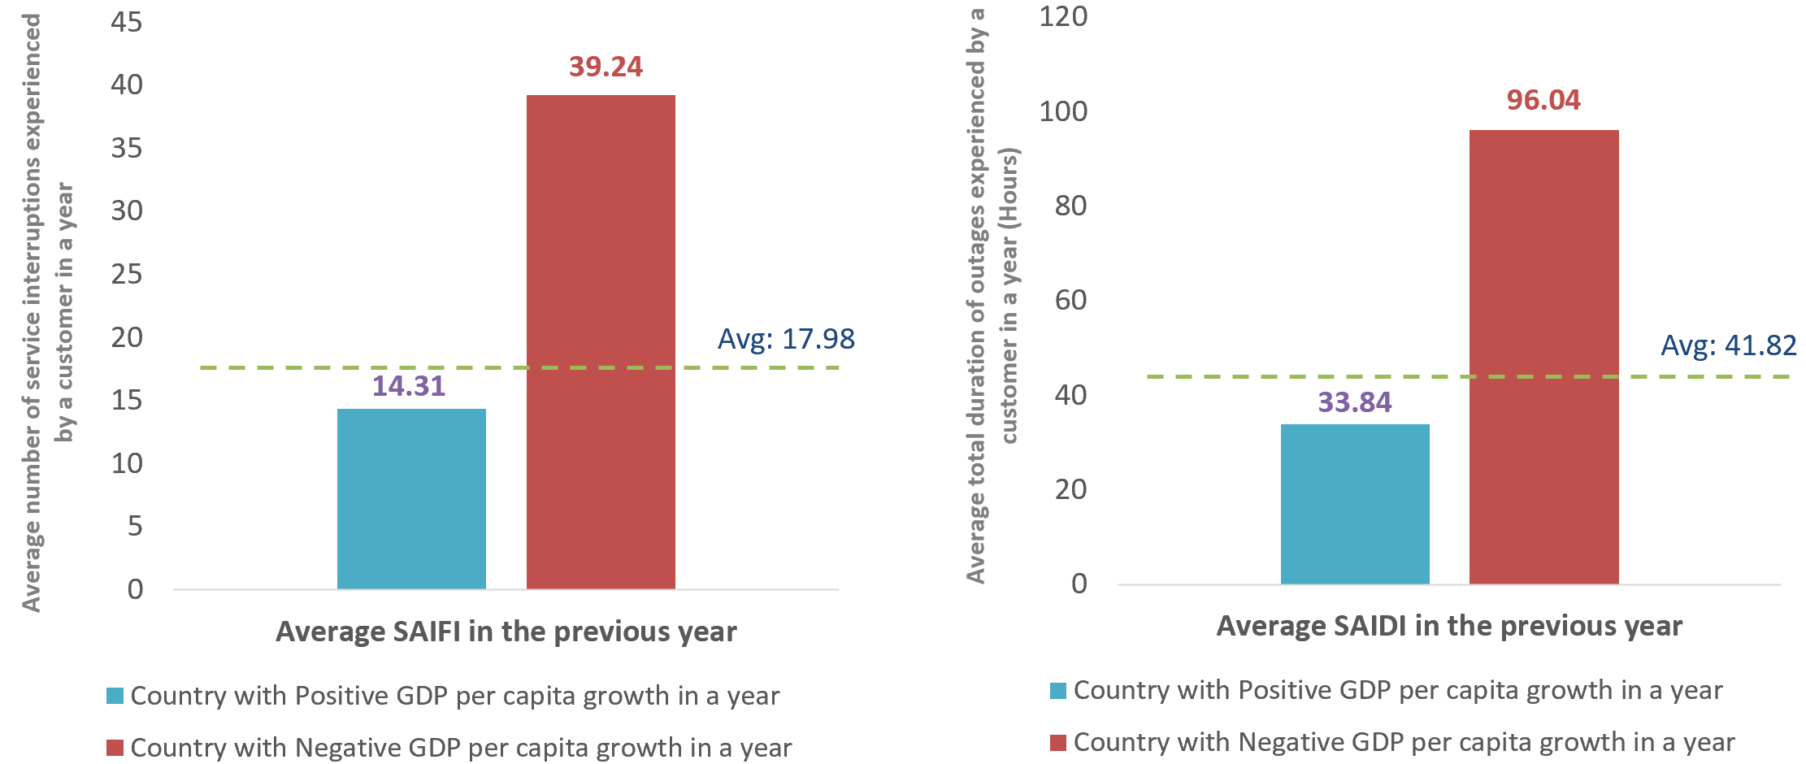
Poor reliability of the power system has consequences for economic health; examination of multi-national data shows a pattern between elevated system interruptions and negative GDP growth
Reliability is non-negotiable
LEI analyzed GDP growth statistics and SAIFI/SAIDI data for 152 countries, 2014–2019
Dividing the countries based on positive or negative GDP per capita growth in each year, there is clear correlation with SAIDI/SAIFI measures in preceding year
Negative GDP per capita growth is associated with less reliable electricity grids in the preceding year
System Average Interruption Frequency Index
(“SAIFI”)
System Average Interruption Duration Index
(“SAIDI”)
Notes: The World Bank Doing Business Database provides the country-level SAIFI/SAIDI data from 2014 to 2019.
Sources: World Bank Doing Business Database, World Development Indicator Database.

Slide 7
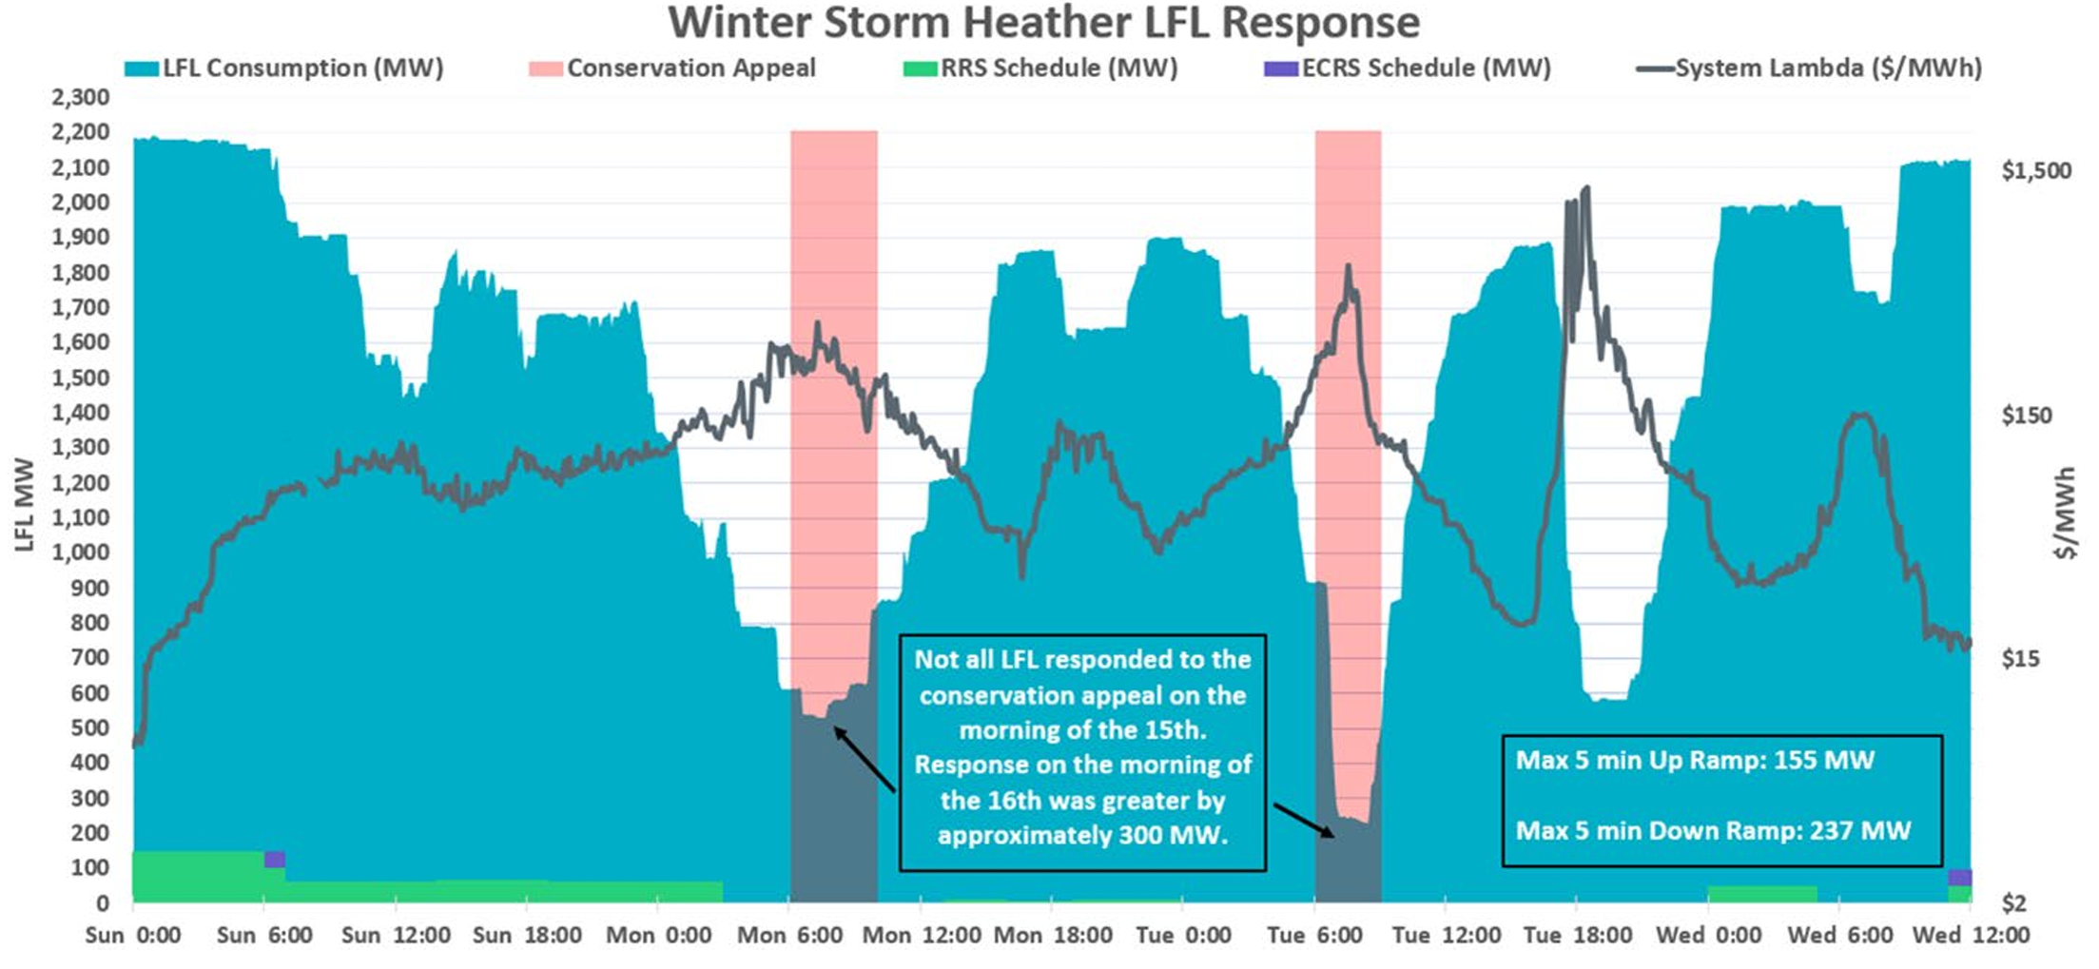
We should no longer assume inelastic demand – customers across different activities are showing responsiveness to prices and other operating signals
Don’t ignore the demand-side of market
ERCOT: Large flexible loads (“LFLs”) are observed to respond to prices under tight conditions
2300
1900
1300
$1,500
1600
$150
$/MWh
LFL MW
1000
700
ERCOT’s winter storm Heather saw LFLs reducing consumption by nearly 2 GW
$15
400
100
$2
Sun 0.00 Sun 12:00 Mon 0:00 Mon 12:00 Tue 0:00 Tue 12:00 Wed 0:00 Wed 12:00
For a subset of LFLs, ERCOT estimated the average strike price for facilities participating in Bitcoin mining. The estimate was derived using the economics of an S19j Pro miner under prevailing Bitcoin market conditions during the event, resulting in an estimated average strike price of $122/MWh
Sources: ERCOT (2024).

Slide 8
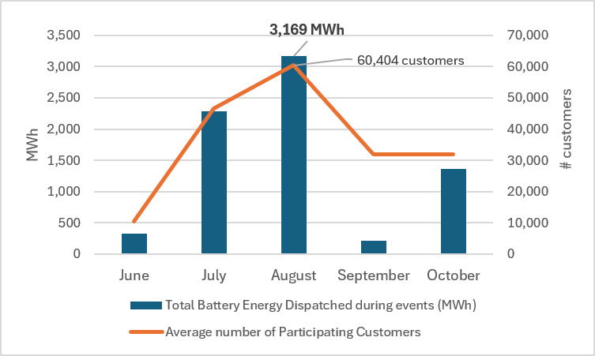
Even residential and small commercial customers are able to make meaningful contributions to wholesale markets and benefit others
Don’t ignore the demand-side of market
Spotlight: Valuing the “insurance” provided by demand response
In just August 2025, demand response from CBES prevented manual load shed on 5 separate days
A 2025 study by LBNL estimated that a 24-hour, Puerto-Rico-wide outage would have resulted in over $1 billion of power interruption costs
If each avoided manual load shed prevented cascading outage, the potential avoided costs during August alone could be over $5 billion
Puerto Rico Customer Battery Energy Sharing (“CBES”) –
Demand Response activations in June - October 2025
Based on statistics from Sunrun (CBES program administrator), CBES involved participation of 34,000 homes and 38,500 batteries, providing on average 23.8 MW to the Puerto Rico power grid per event (CBES resources deployed in 43 events over June –October 2025)
Sources: Negociado de Energia docket (“NEPR”), Lawrence Berkeley National Laboratory (“LBNL”), and LEI calculations.

Slide 9
Investing in electricity-intensive sectors, as well as in the electricity infrastructure used to serve them, is a catalyst to economic growth – this phenomenon is known as the “multiplier” effect
Build around the customer
What happens when we have a $632 million investment opportunity to build a new steel production facility in the U.S.?
  It will require generation and transmission investment totaling $192 million
  Not all the money will be spent in the U.S. – for both the steel mill and electric infrastructure, domestic spending on construction services will total about $400 million
Example of CONSTRUCTION PHASE (short-term):
GDP and employment growth (3 years)
Example of OPERATING PHASE (long-term): annual GDP & employment growth
GDP
Total $918 million
Employment
Total 3,474 jobs
GDP
Total $94 million
Employment
Total 415 jobs
I+I
D
Steel Industry | Direct (“D”) Effects Electricity Infrastructure | Direct Effects
Steel Industry | Indirect + Induced (“I+I”) Effects Electricity Infrastructure | Indirect + Induced Effects
A total investment of $632 million could generate over $900 million in total economic impact (1.5x multiplier) and create almost 3,500 new jobs…
… and an additional +$90 million in economic activity (1.4x multiplier) and +400 new jobs in the long-term
Sources: 2025 CONE Report for PJM, 2024 NREL ATB. This analysis was performed using REMI-PI+.

Slide 10
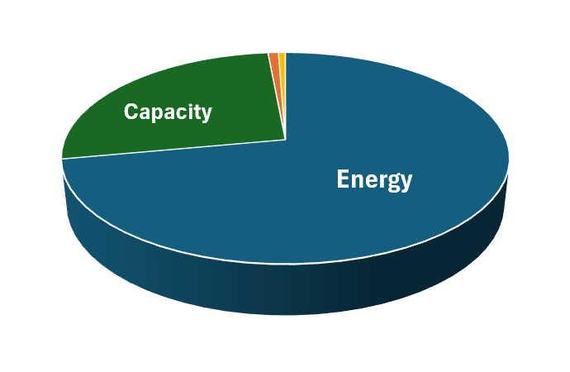
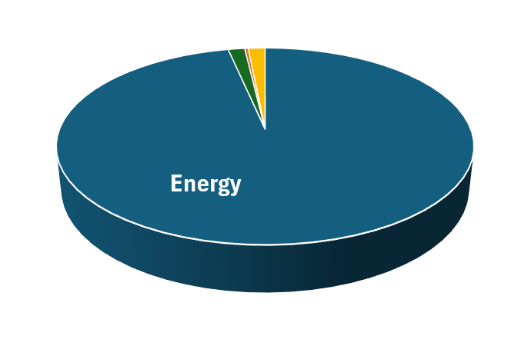
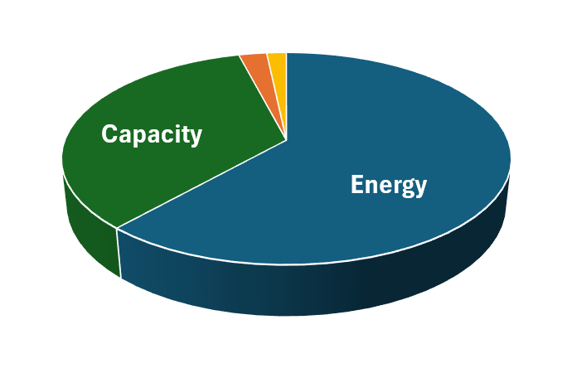
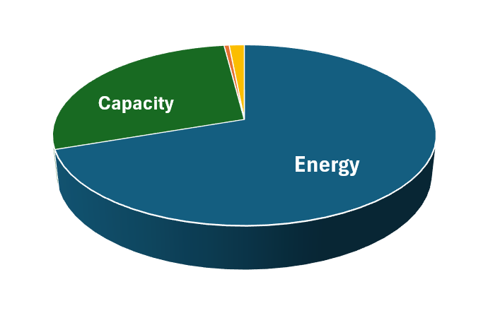
Historically, the lion’s share of market value resided in the market price of energy, even with ISOs purchasing ancillary services and stand-alone capacity
Energy vs. Reliability and Flexibility
Ancillary services and operating reserves together only account for less than 10% of wholesale product costs by ISO/RTO in some major US markets
ISO-NE
Ancillary services + Operating reserves: 1.5%
MISO
Ancillary services + Operating reserves: 1.7%
NYISO
Ancillary services + Operating reserves: 3.6%
PJM
Ancillary services + Operating reserves: 1.7%
Notes: The total expenditure in the graphs includes costs for purchasing energy, capacity, operating reserves, and ancillary services by RTO/ISO. Data are based on the average costs of 2019 – 2022, if available.
Sources: FERC 2023 Common Metrics Report and 2022 NYISO State of the Market Report (Potomac Economics).

Slide 11
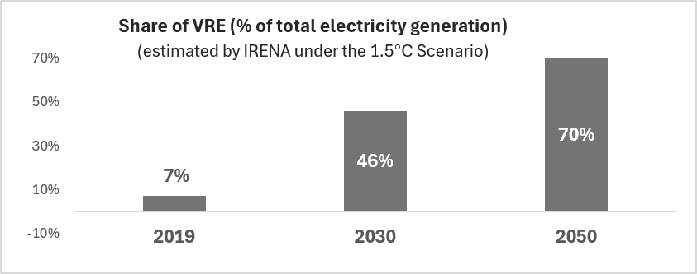
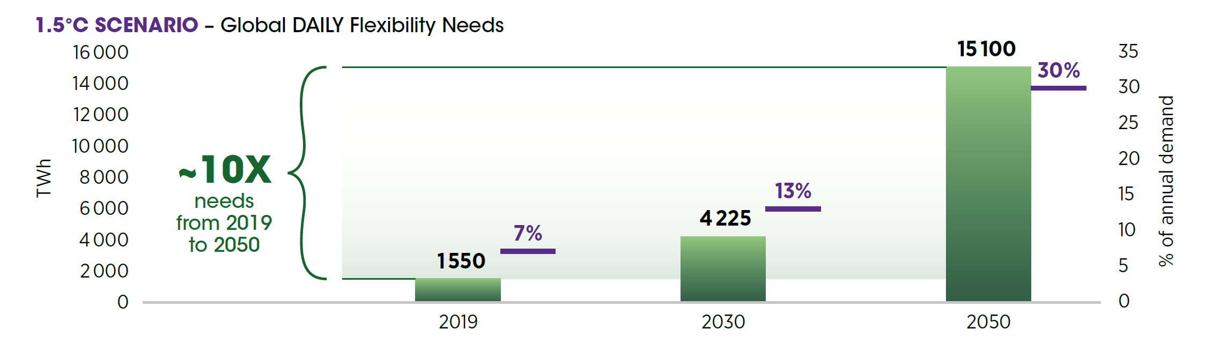
Power system flexibility is expected to become more valuable with increased renewable penetration and rising net load uncertainty
Energy vs. Reliability and Flexibility
International Renewable Energy Agency (“IRENA”) 2026 study findings: Rising variable renewable energy (“VRE”) penetration is increasing the need for a diverse portfolio of flexibility resources to maintain a secure and cost-effective power supply
As the global wind and solar generation rises from 9% of total electricity generation in 2019…
…to an estimated 46% in 2030 and 70% in 2050…
70%
50%
30%
10%
-10%
…Daily flexibility needs for the power sector would increase 10x to manage the daily variability of net load （from 7% in 2019 to 30% by 2050 as share of annual electricity demand)
Notes: IRENA’s definition of flexibility needs are quantified by measuring the cumulative energy (annual TWh) deviation of the net load (demand minus VRE generation) from its average value over the defined timescale.
Source: International Renewable Energy Agency

Slide 12
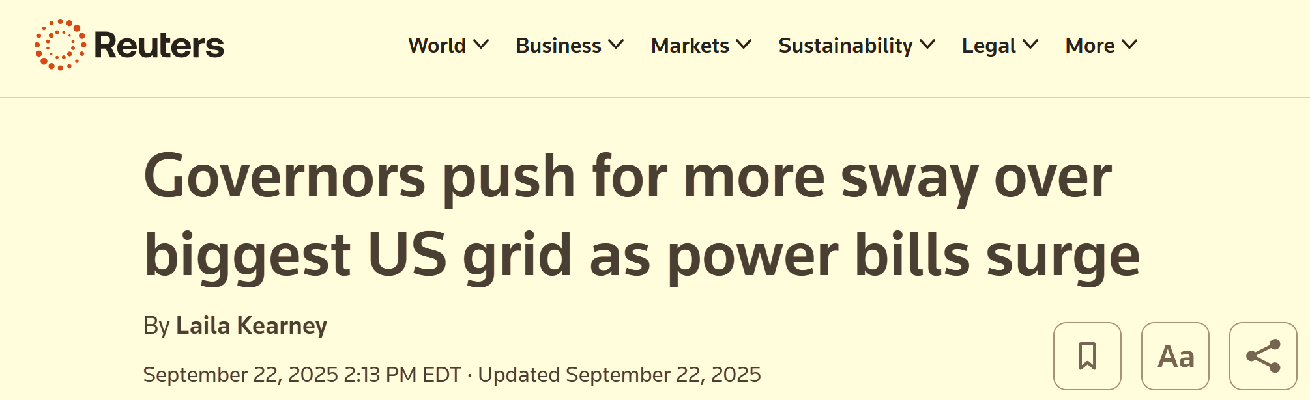
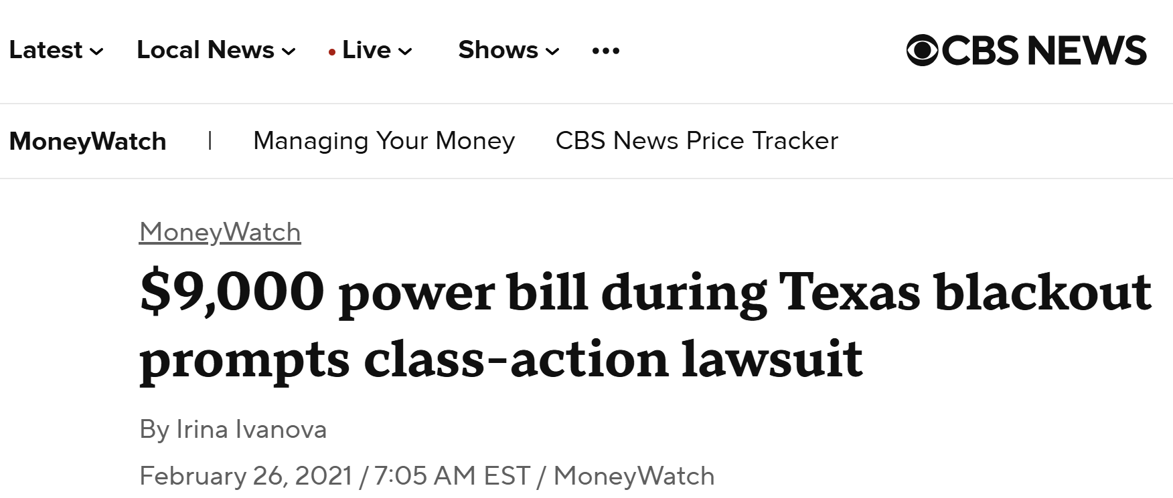
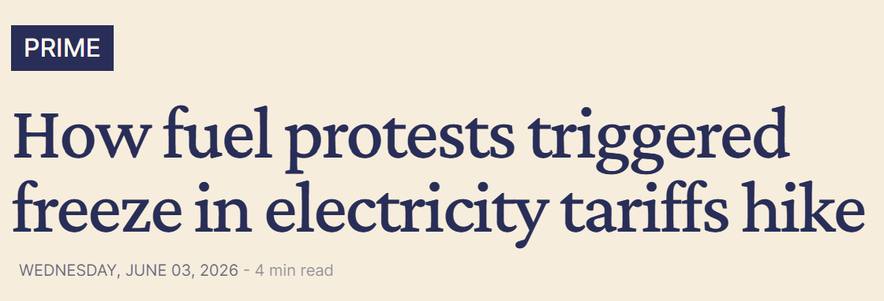

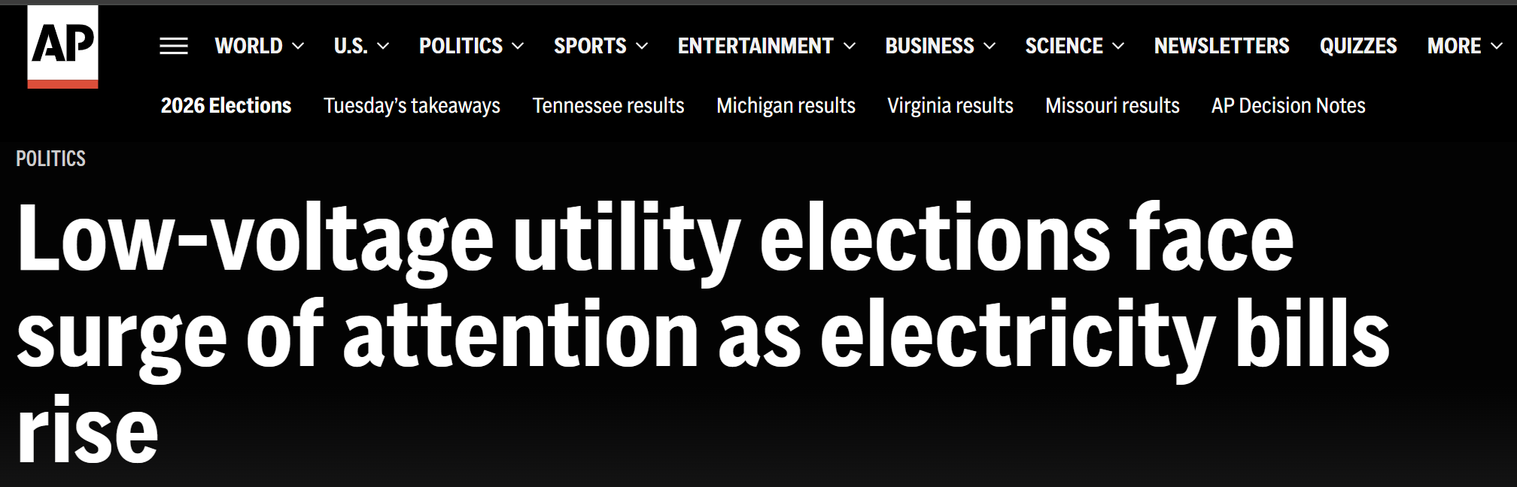

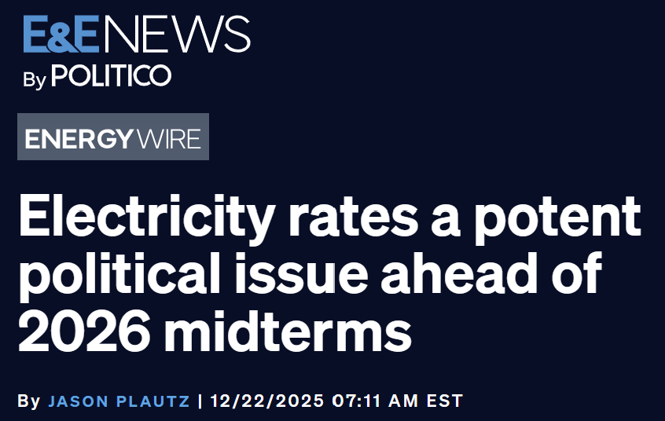
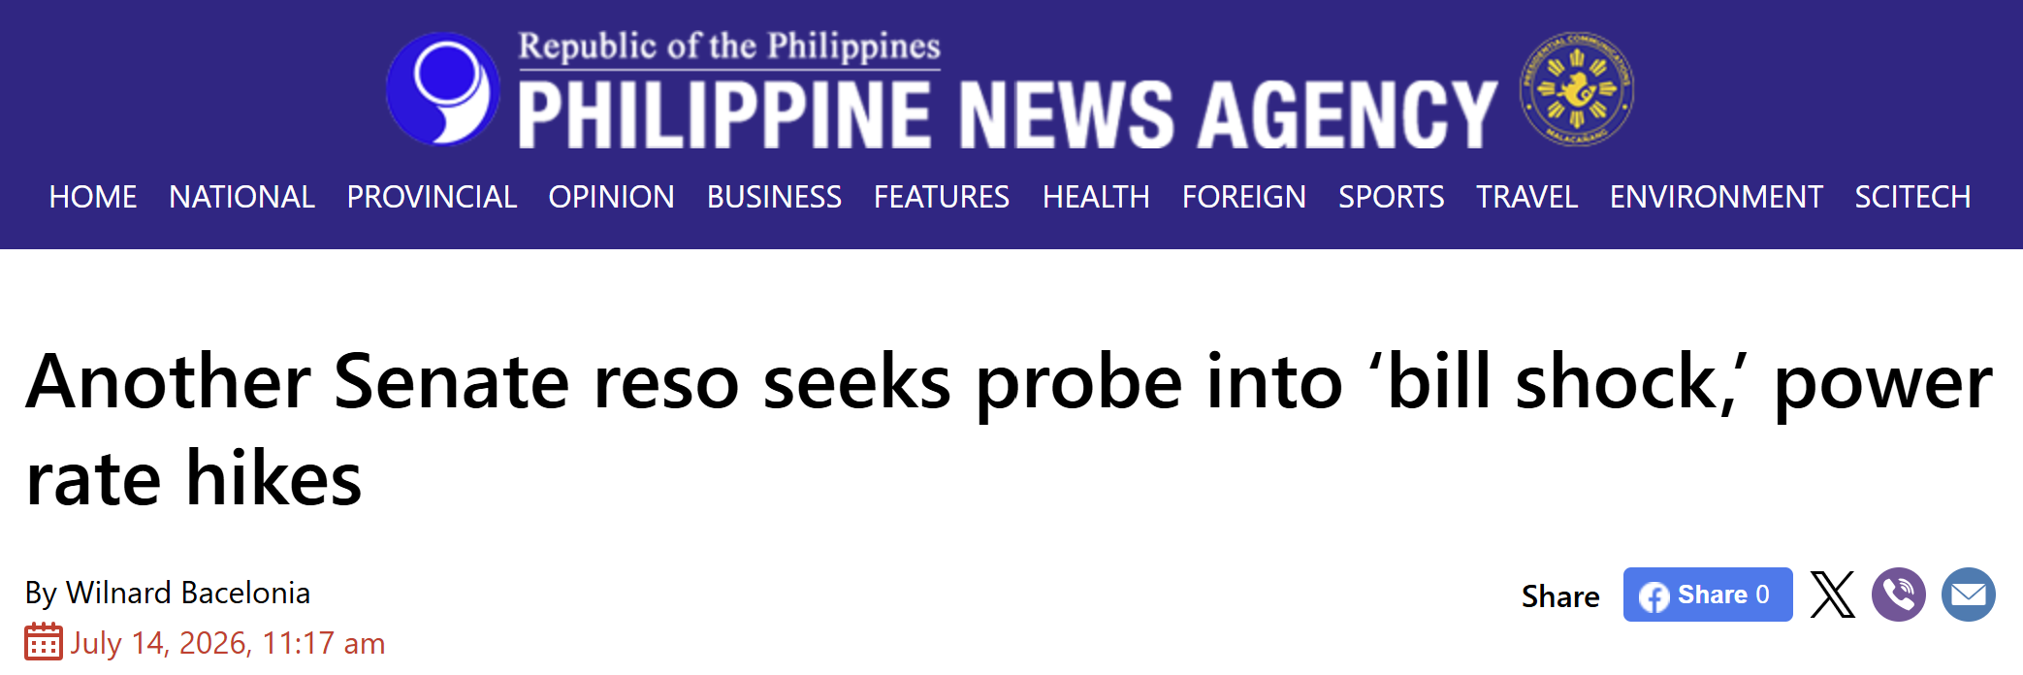

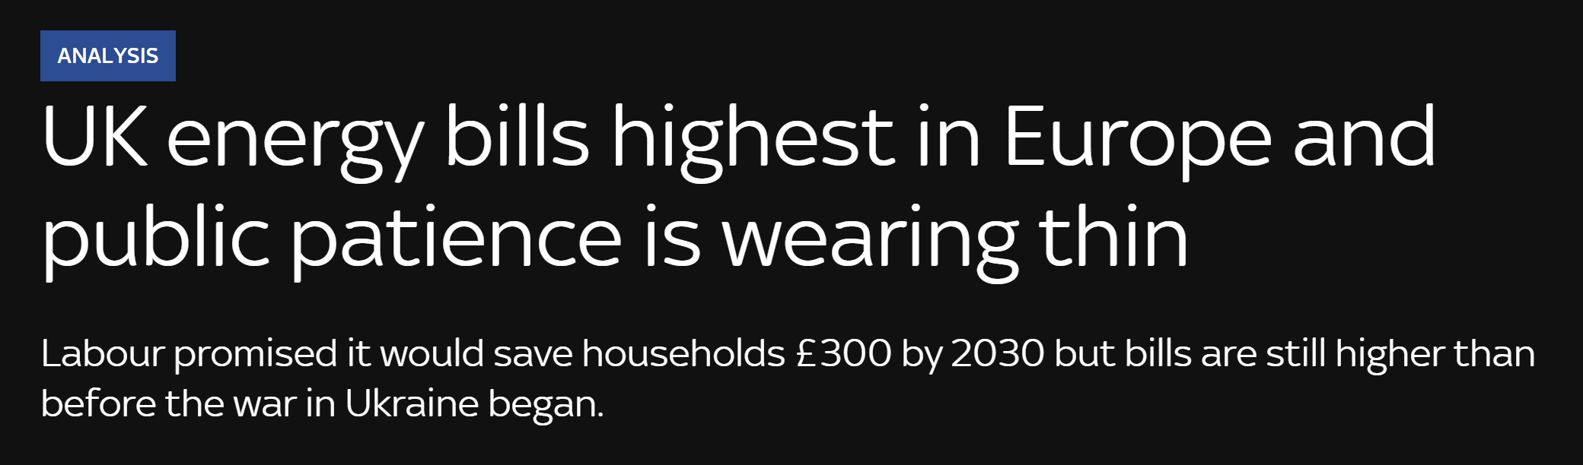

Electricity prices are inherently political because electricity is essential to households and businesses and carries a historical legacy of monopoly service and extensive regulation
Withstanding political pressure
Sources: Reuters, CBS News, Sky News, Politco, Associated Press, Philippine News Agency, Time, India Today, The Hill, Business Daily Africa.

Slide 13
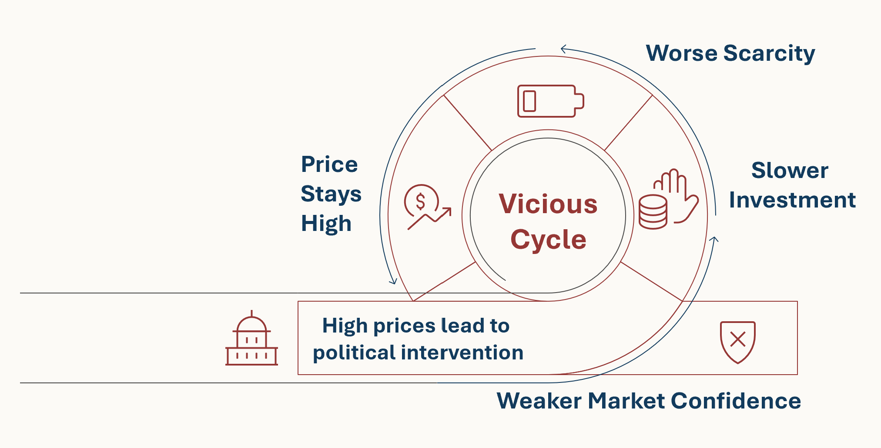
Political scrutiny of the electricity costs is a deep-rooted aspect of our society, making adoption of textbook “free-market” framework unrealistic
Withstanding political pressure
3
4
2
1
We need market institutions and regulations to be resilient to political intervention - credible, transparent, and socially sustainable

Slide 14
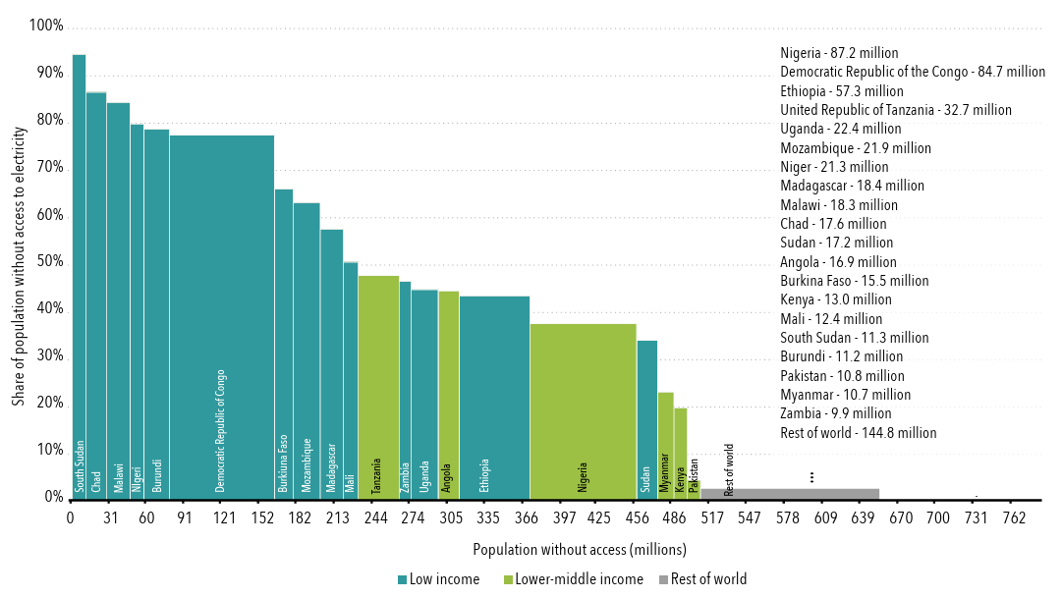
Basic electricity access remains a persistent issue in many countries around the world
Improving outcomes for all
Share of population without access to electricity in top-20 access-deficit countries, 2024
16
Classification based on Gross National Income (“GNI”) per capita:
Low income: GNI < $1,175
Lower-middle income: GNI between $1,176 and $4,635
Rest of the word: GNI >$4,635
1
2
3
4
5
6
7
8
9
10
11
12
13
14
15
16
17
18
19
20
21
10
9
7
2
17
13
6
8
15
4
20
12
3
5
1
11
19
14
18
21
UN estimated $30 billion in annual funding is needed in transmission, distribution, and generation infrastructure between 2021 and 2030 to reach universal electricity access
Sources: World Bank Energy Tracking Report (2026), World Bank, International Renewable Energy Agency (2024).

Slide 15
One challenge for the power market is to ensure that industrial expansion strengthens the public grid rather than bypassing it
Improving outcomes for all
Industrial customers across sectors turn to behind-the-meter generation to secure reliable, dedicated power supply
MW | Alberta (2025) | Chile (2025) | ERCOT (Texas, 2025) | Western Australia (2024)
Residential off grid / self-supply (rooftop solar and other DERs) | ~441 (6%) | 503 (5%) | 1,238 (2%) | 2,180 (10%)
Commercial & Industrial off grid / self-supply | ~2,412 (32%) | 3,000 (31%) | 9,547 (17%) | 330 (2%)
Average Demand | 7,465 | 9,720 | 55,734 | 21,287
% of BTM installed capacity over average demand
38%
36%
19%
12%)
Sources: Australian Department of Climate Change, Energy, the Environment and Water, Sustainable Energy Now (“SEN”), Alberta Electric System Operator(a) (“AESO”), AESO(b), Chilean Power Coordinator, ERCOT(a), ERCOT(b).

Slide 16
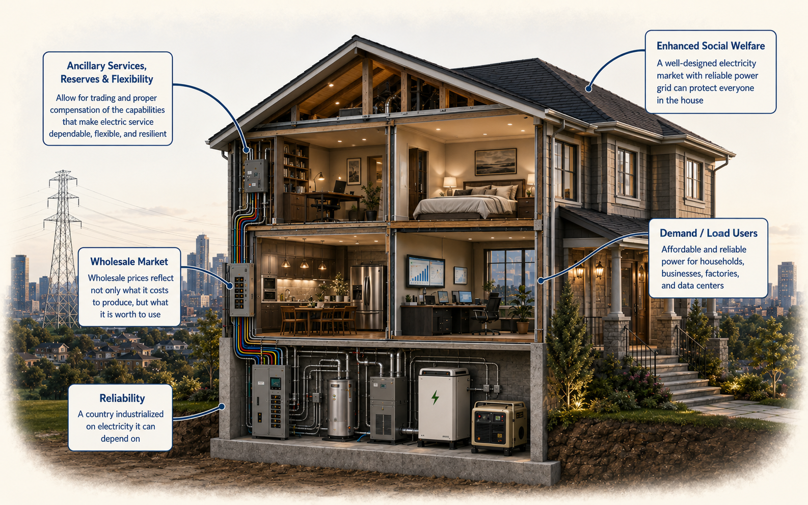
Electricity sector can be like a custom-built home – the more thought we can put into the planning and design, the more value and enjoyment we will receive from the final product
Concluding remarks
Protect those under the same “roof” (Inclusive)
a more reliable and affordable electric power system should benefit everyone
Design for the Customer
market design reforms should start with needs of customers
Grid connection matters (and its Two Way)
customers are price elastic; market rules should reflect demand side value
Avoid patches; fix problems
market rules should be credible, socially sustainable to be able to withstand political pressure
Reliability is the foundation
reliable electricity is a basic requirement to a well-functioning economy
Ensure integrity of overall structure
Markets need to reward flexibility and reliability
Designing electricity markets and commercial arrangements, and planning for infrastructure and institutions capable of supporting the economy we want

